Slide 1
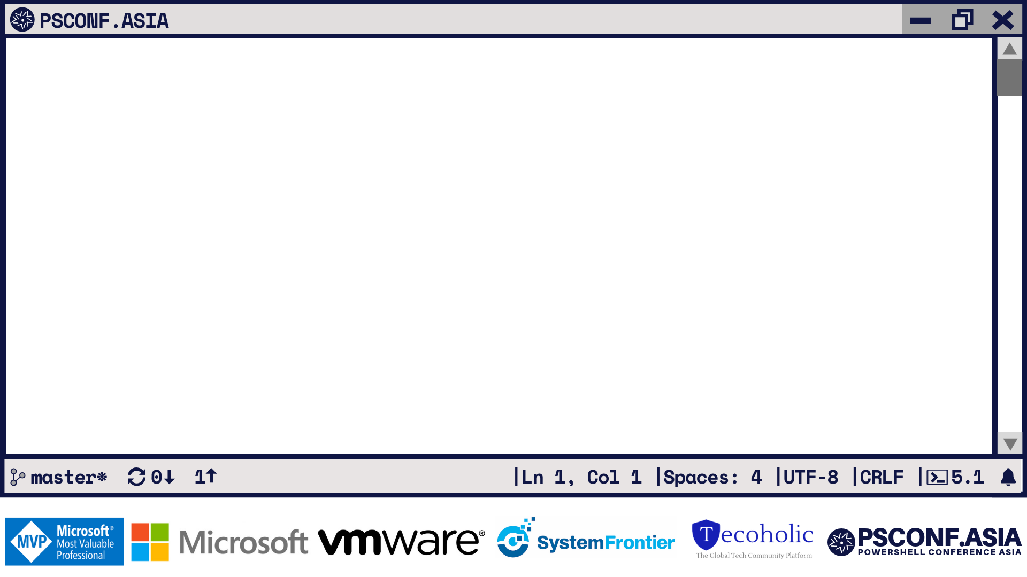
Power of the Console
Azure Cognitive Services
to Colorful consoles and Grids

Slide 2












PS C: >_ whoami
TECH. WRITER FOR
BOOKS AUTHORED
CONTRIBUTING AUTHOR
PRATEEK SINGH
RIDICURIOUS.COM
/SINGHPRATEIK
/PRATEEKKUMARSINGH
/RIDICULOUSLYCURIOUS
LEANPUB.COM/B/BOOKS

Slide 3

“The only limits to the possibilities
in your life tomorrow are,
the buts you use today.”
“The only limits to the possibilities
in your life tomorrow are,
the buts you use today.”
Les Brown

Slide 4

PS C: >_ Get-Agenda
What is REST
Azure Cognitive Services
Demo 1: PowerShell + Cognitive Services
Crash Course: PSHTML, Polaris, Gridify, Graphical
Demo 2: Making a Live Twitter Dashboard

Slide 5
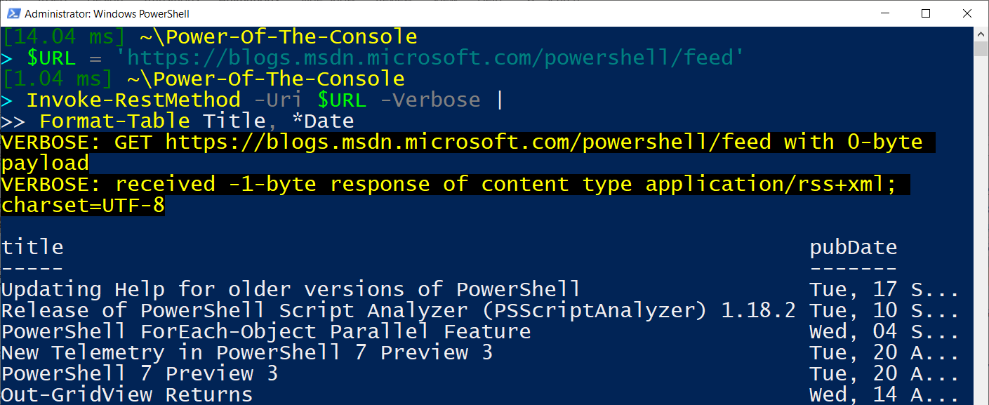
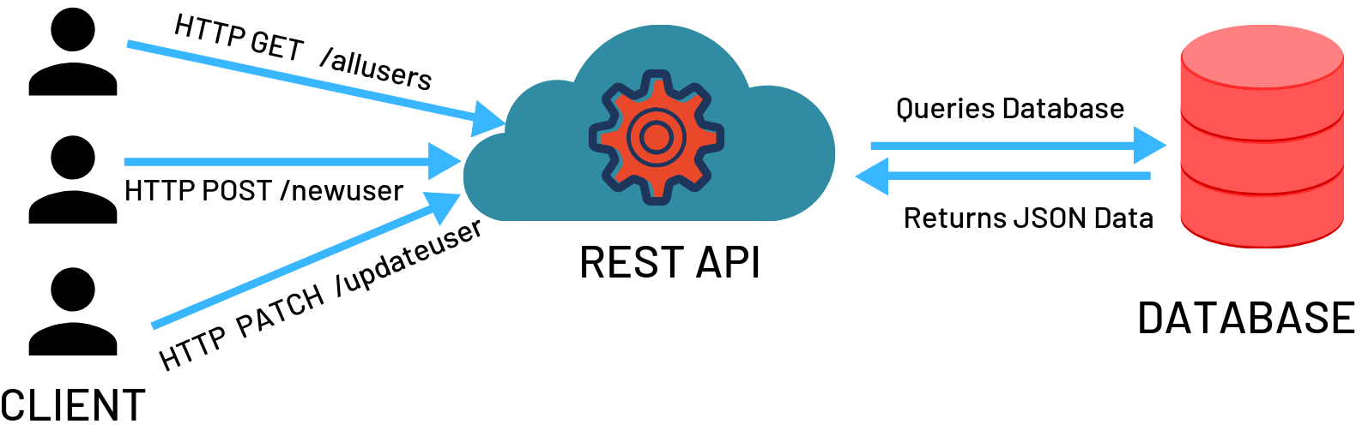
PS C: >_ Get-Help *REST*
REpresentational State Transfer
Software architectural style to create Web services.
Web services that use REST are called RESTful Web services.
Provides Interoperability and Information exchange

Slide 6
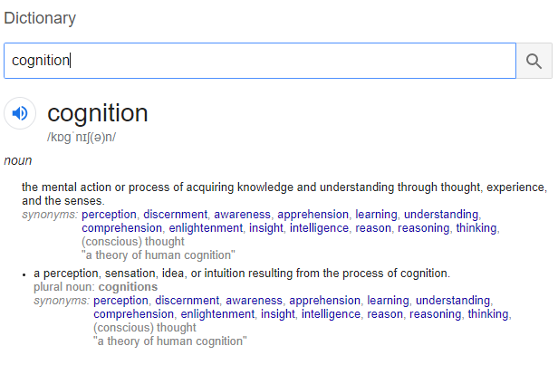







PS C: >_ Start-Process http://aka.ms/cognitive-services
Cognition = Acquiring Knowledge and Understanding
Azure Cognitive Services provide intelligent algorithms that can
See
Hear
Speak
Understand
Interpret
Azure cloud based REST APIs
Any device
From anywhere
Text to Speech
Computer Vision
Content Moderation
Speech Translation
Sentiment Analysis
Text Analytics
Web Search

Slide 7
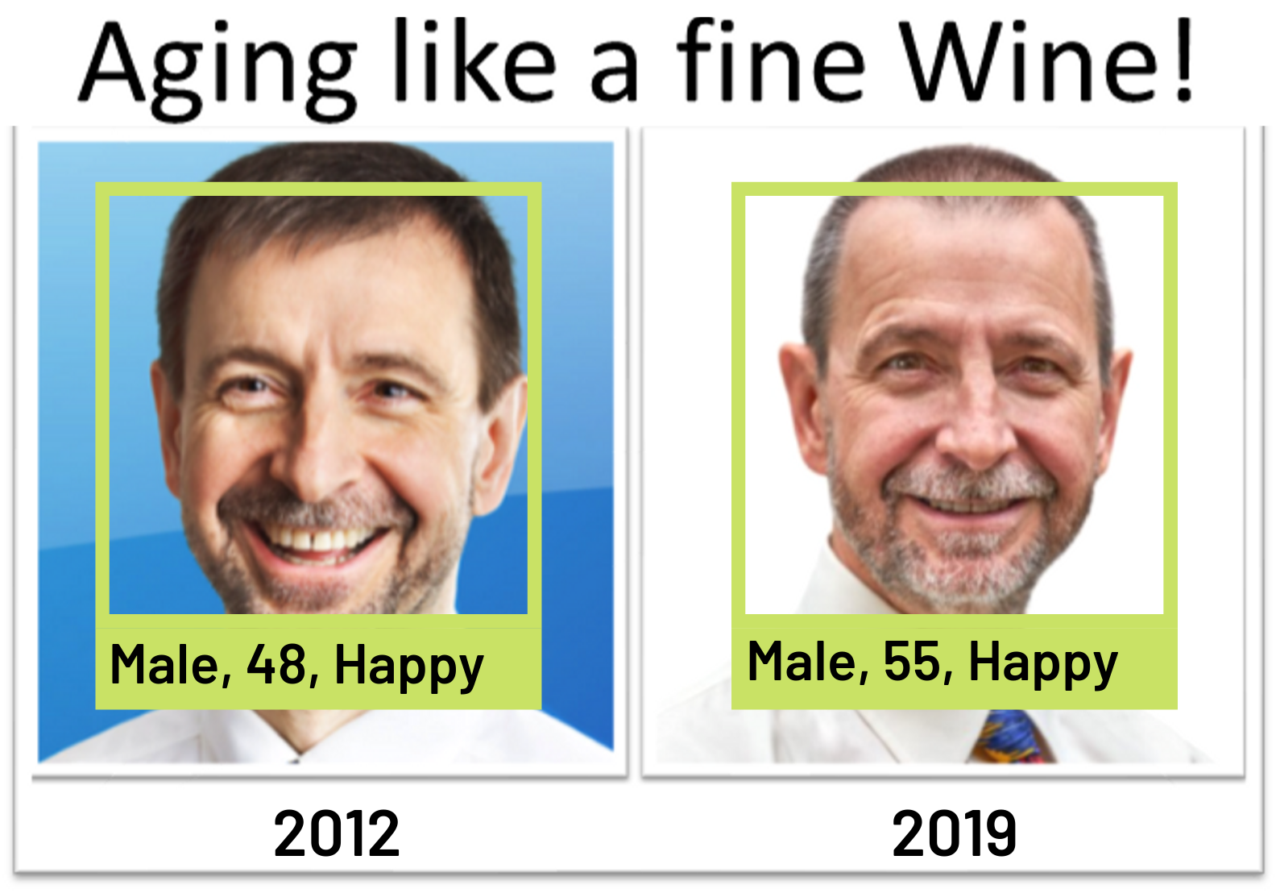


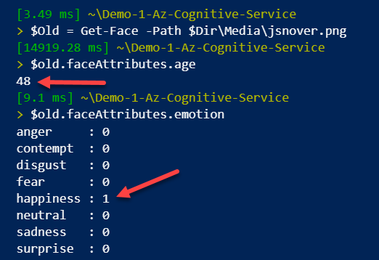
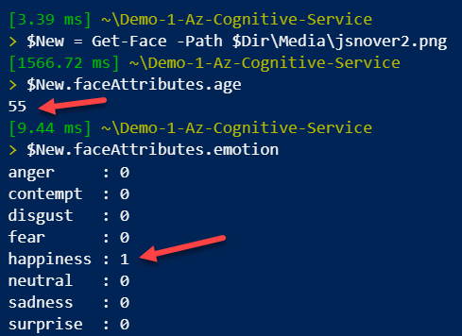

Slide 8
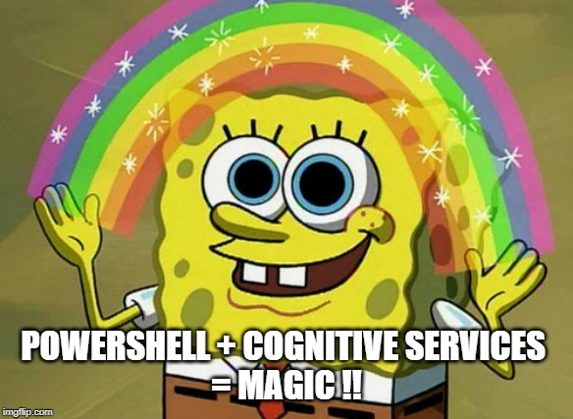

Slide 9
Demo-1
PowerShell + Azure Cognitive Service
PS C: >_ Install-Module PSCognitiveService

Slide 10

5 mins Crash Course!
PSHTML + Polaris Gridify + Graphical

Slide 11
Demo-2
Live Twitter Dash Board

Slide 12



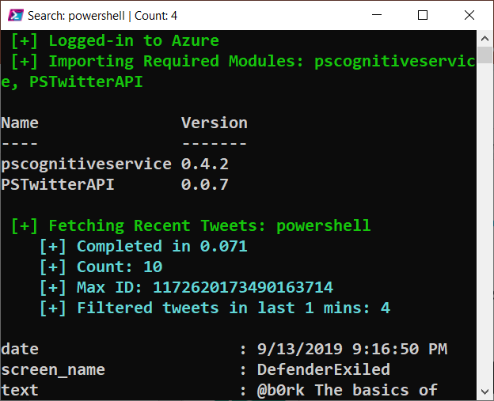


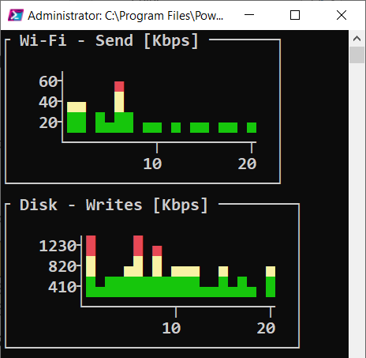

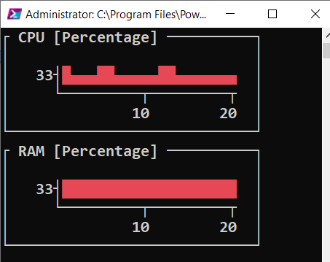
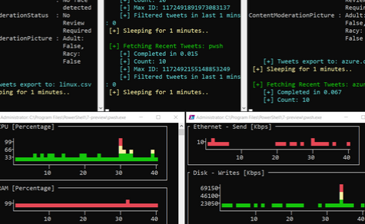

PS C: >_ Get-Help Twitter*Dashboard -Full
Image
Moderation
Text
Moderation
Sentiment Analysis
Twitter Search API
Computer
Vision
3
Invoke-RESTMethod
4
5
PSCognitiveService Module
KEYWORDS:
PowerShell, DevOps
KEYWORDS:
PowerShell, DevOps
Azure Cognitive Services
Get-Tweet.ps1 Invoke-Perfmon.ps1
1
Spawner.ps1
2
Start-Process pwsh
PSHTML Module
6
WebServer.ps1
7
<HTML>
Monitoring & Control Console Grids
Polaris Web Server
Live Twitter Dash Board

Slide 13
PS C: >_ Get-Resource
PowerShell Modules:
https://github.com/PrateekKumarSingh/PSCognitiveService
https://github.com/PrateekKumarSingh/Graphical
https://github.com/PrateekKumarSingh/Gridify
https://github.com/mkellerman/PSTwitterAPI
Use cases, API’s and Language Bindings
https://aka.ms/cognitive-services
Slides
https://github.com/prateekkumarsingh/presentations

Slide 14
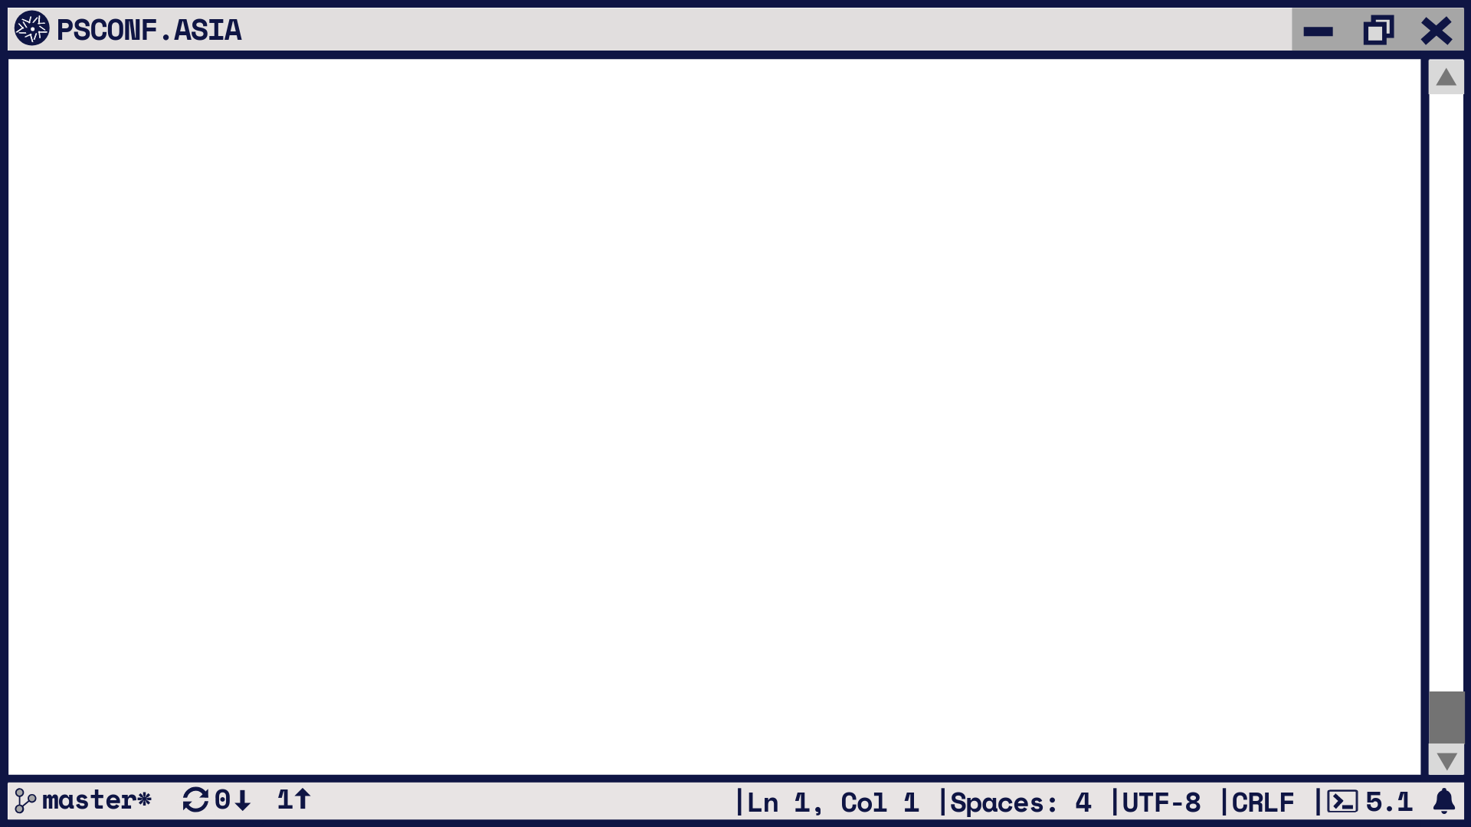

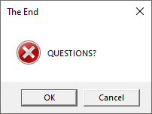
PS C: >_ Exit

